Slide 1

INTERNSHIP PRESENTATION
PRESENTED BY - VIAHAL KUMAR 1AM17IS096^{8TH} SEM ISE
UNDER THE GUIDANCE OF PROF. RAHUL.B DEPARTMENT OF ISE

Slide 2
CONTENT
About Company
Title
Introduction
Requirements Specification
System Design
Implementation
Results and Analysis
Advantages
Conclusion

Slide 3
ABOUT COMPANY
◆ Tequed Labs is a research and development center and educational institute based in Bangalore started by Mr Aditya S K and Mr Supreeth Y S.We are focused on providing quality education on latest technologies and develop products which are of great need to the society.
The director and ceo is Supreeth Ys.
They also run a project consultancy where we undertake various projects from wide range of companies and assist them technically and build products and provide services to them .
We are continuously involved in research about futuristic technologies and finding ways to simplify them for our students .

Slide 4
Title “CRICKET PLAYER PERFORMANCE PREDICTION”

Slide 5
Introduction
◆ Machine learning involves computer to get trained using a given data set, and use this training to predict the properties of a given new data
◆ There are various machine learning algorithms like Decision trees, Naive Bayes, Random forest, Support vector machine, K-nearest neighbour, K- means clustering, etc.
◆ Machine learning is one of the applications of
python.
◆ The most recent major version of Python is Python 3, which we shall be using in this tutorial

Slide 6
Requirements Specification
◆ Hardware Requirements
Processor i3 and above.
Ram 4gb and above.
◆ Software Requirements
Anaconda navigator as an applications wrapper hub.
Jupyter Notebook as GUI interface for coding.
◆ Libraries Required
Pandas.
Matplotlib.
Sklearn.linear_model

Slide 7
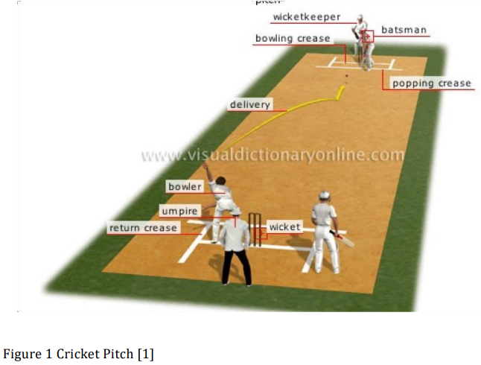
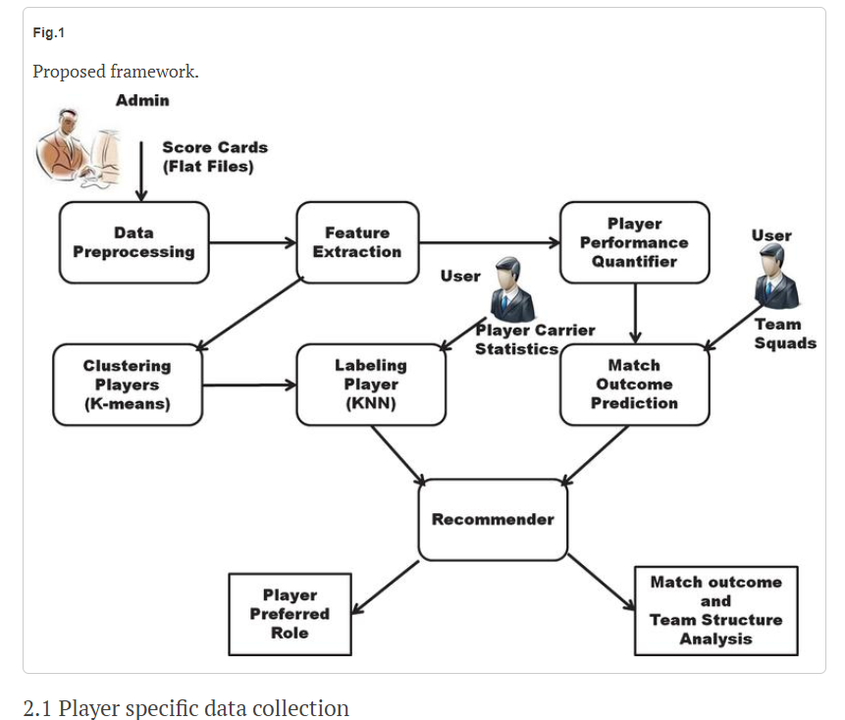
System Design

Slide 8
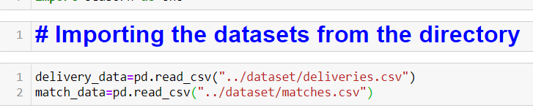
Implementation
1 Importing Libraries.
2 loading Dataset

Slide 9
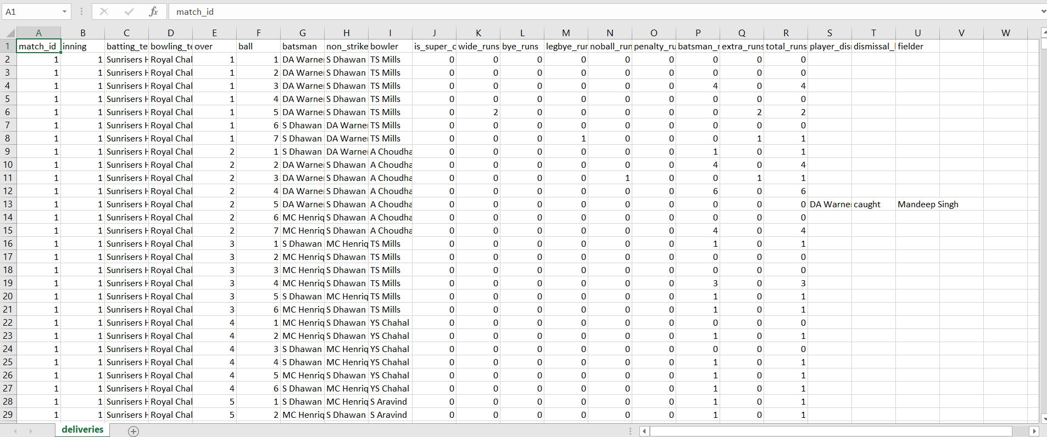
3 Overview of Dataset
#deliveries.csv

Slide 10
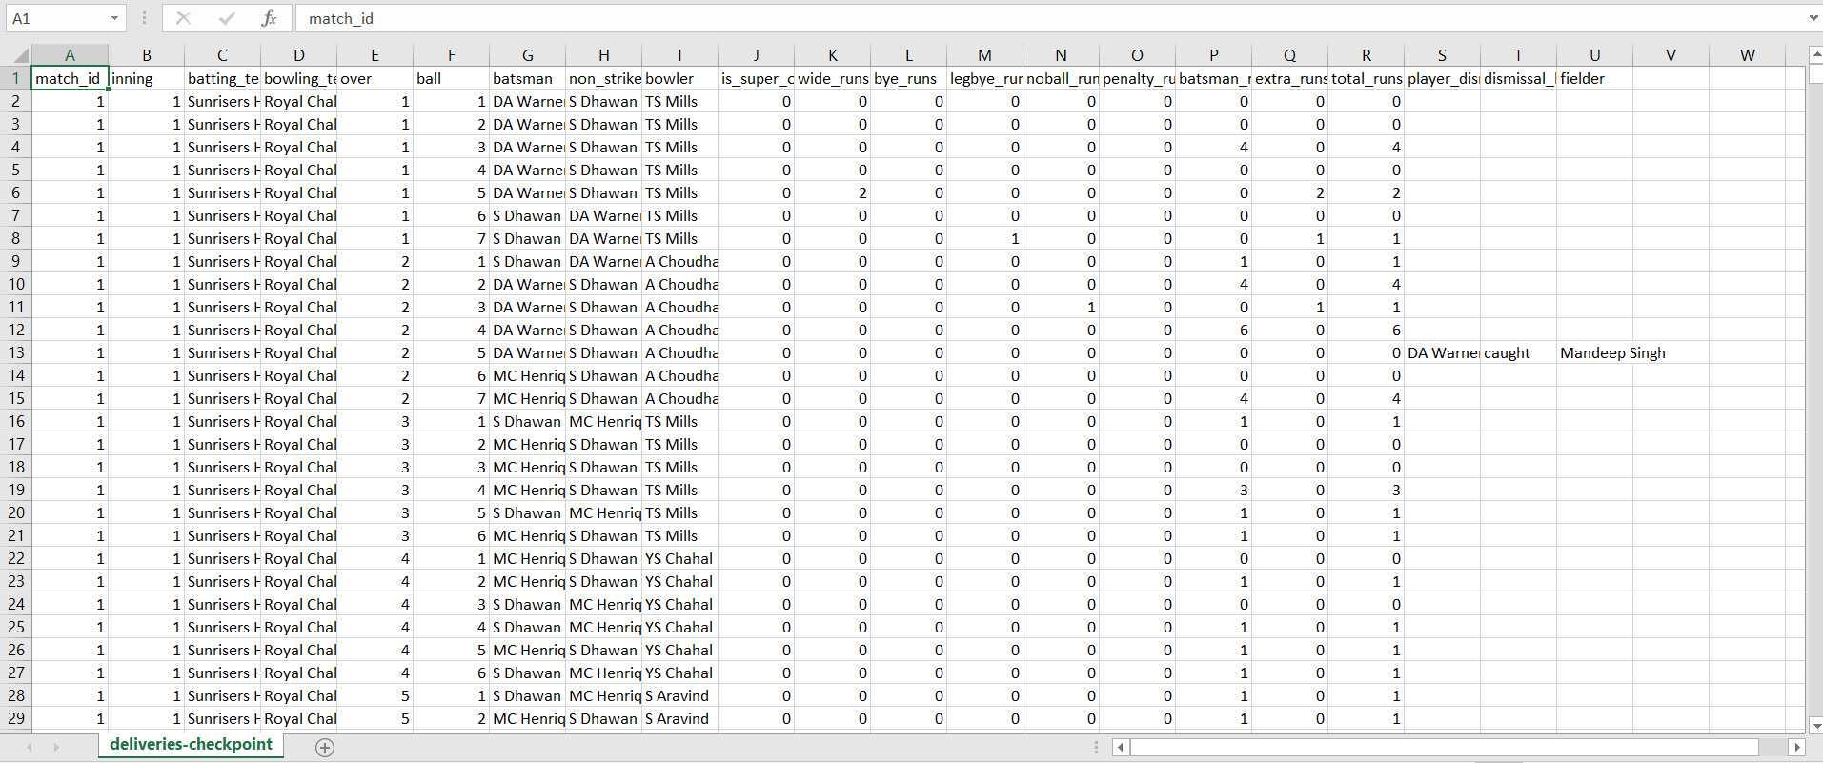
3 Overview of Dataset
#deliveries_checkpoints.csv

Slide 11
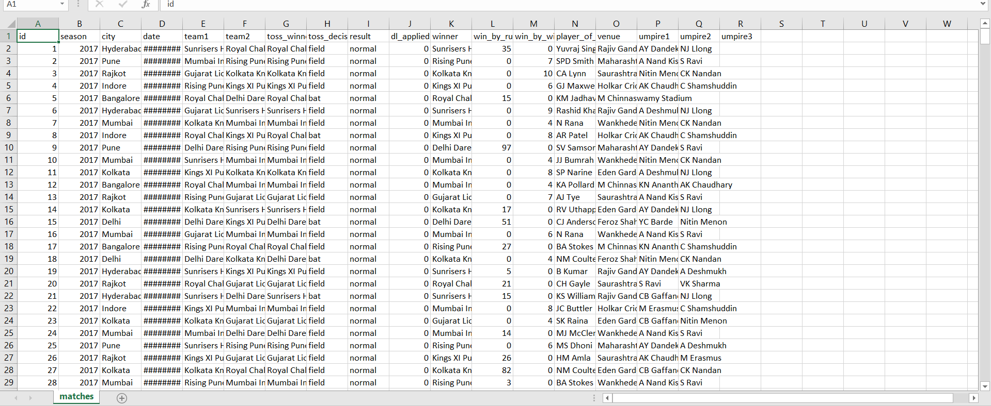
3 Overview of Dataset
#matches.csv

Slide 12
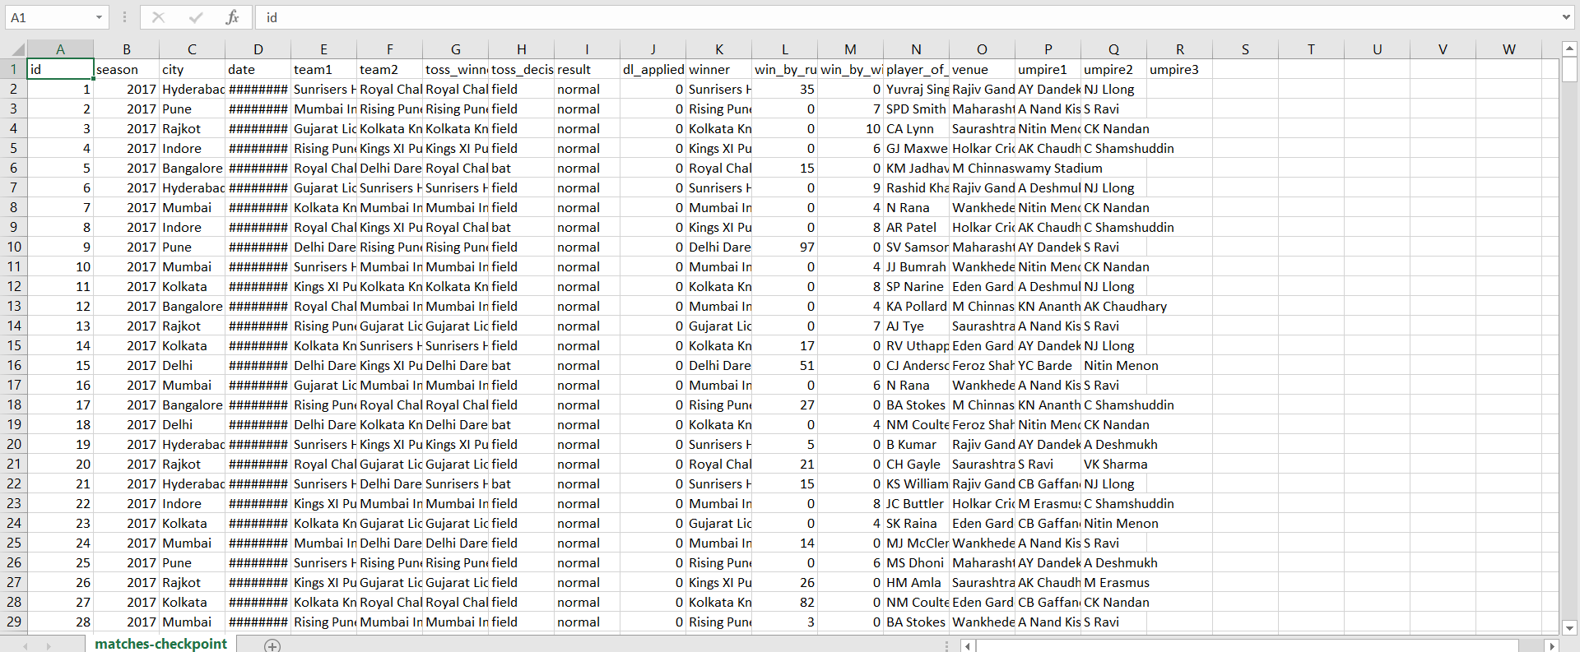
3 Overview of Dataset
# matches checkpoits.csv

Slide 13
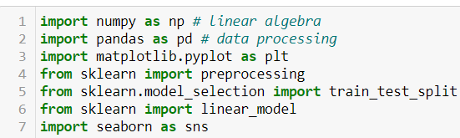
IMPORTING CLASSES

Slide 14
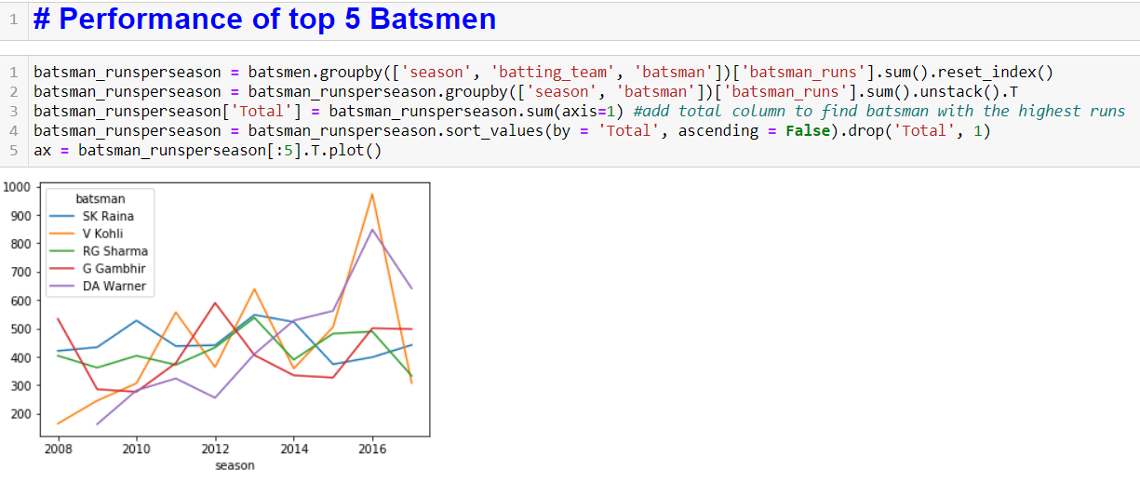
Accuracy of the Predictions

Slide 15
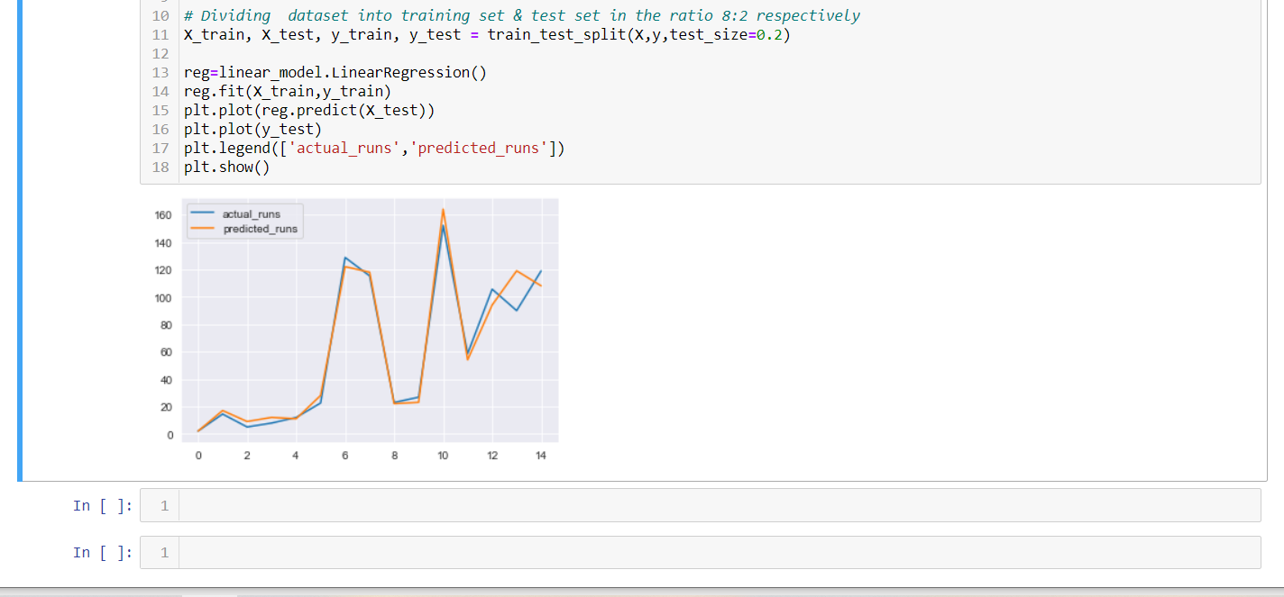
Graph Predicting player's performance using Linear Regression

Slide 16
Advantages
◆ Technical Outcomes
Working with Anaconda navigator
Hands on experience with projects “Cricket Player Performance Prediction”ANLYSIS USING MACHINE LEARNING.
Verbal and Written Communication Skills.
Personality Development
Time Management
Resource Utilization Skills

Slide 17
Conclusion
◆ Thus we have analysed the cricket data set and some features
◆ Graph and figures to make our predictions
◆ As concluded open scope for future work in the
field of cricket and prediction other things.

Slide 18
THANK YOU

